Slide 1

Exploratory Data Analysis of U.S. Chronic Disease Data Insights into Trends, Geography, and Topics
By: Group 2

Slide 2
Project Overview
Problem Statement
Chronic diseases significantly impact public health in the U.S., yet understanding their distribution at the state level is challenging due to data inconsistencies and missing values. This project analyzes the CDC's Chronic Disease Indicators dataset to reveal key trends and geographic variations, providing insights to support targeted public health interventions
Aims
Identify State-Level Disparities: Pinpoint states with notably high or low chronic disease prevalence.
Analyze Temporal Trends: Examine how disease prevalence has evolved over time.
Compare Across Topics: Investigate variations in chronic disease indicators across different health topics.
Inform Policy: Deliver data-driven insights to guide public health strategies.

Slide 3
Dataset Overview
Source: U.S. Chronic Disease Indicators from the CDC Data Portal ( https://data.cdc.gov/....)
Format: CSV file containing 309215 row and 34 columns.
Key Variables: Year (yearstart / yearend), Location (locationdesc, locationabbr), Data values (datavalue, datavalueunit), Topics (topic).
Scope: Covers geographic and temporal dimensions of chronic disease prevalence.

Slide 4
Methodology
Data Acquisition & Cleaning:
Imported dataset using Python (Pandas).
Standardized column names, handled missing values via median imputation and column removal.
Exploratory Data Analysis (EDA):
Generated summary statistics and visualized distributions using Matplotlib.
Business Question Analysis:
Analyzed state-level differences, temporal trends, and topic-based variations.
Visualization & Insights:
Created bar charts, line plots, and histograms for impactful storytelling.

Slide 5
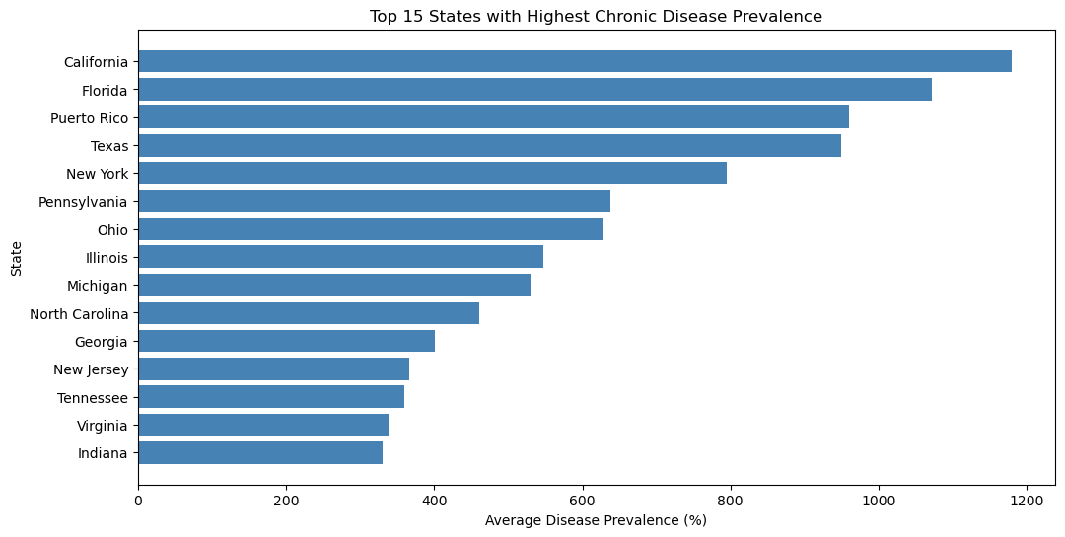
California has the Highest Chronic Disease Prevalence

Slide 6
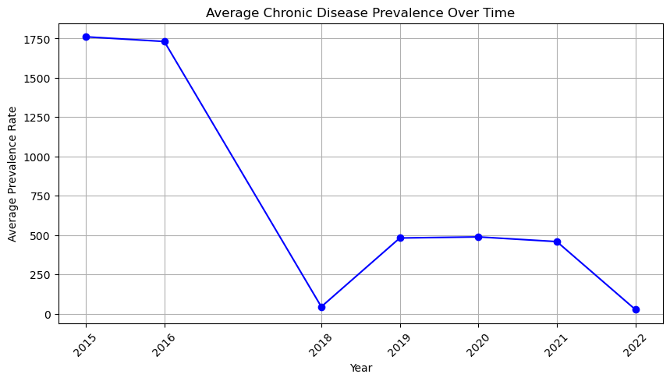
We Are Heading in The Right Direction

Slide 7
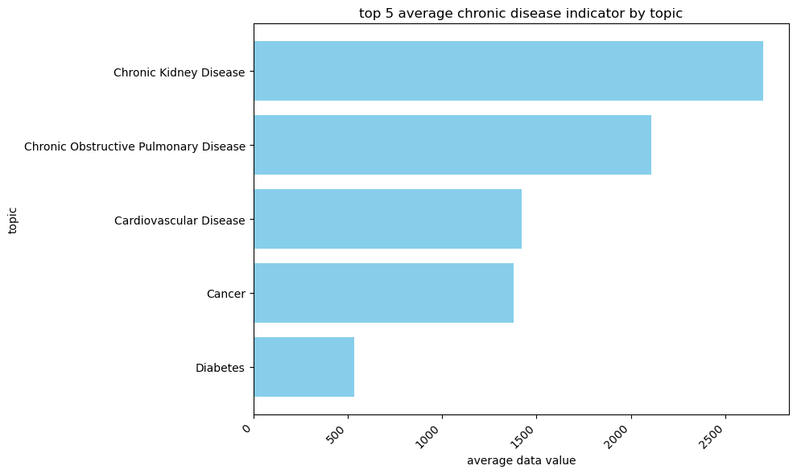
CKD has the Most Indicators

Slide 8
Implications, Recommendations & Future Work
Implications:
Regions with high disease prevalence may require more focused public health initiatives.
The trends suggest potential areas of intervention.
Recommendations:
Increase targeted funding and health education in high-prevalence states.
Conduct further studies to explore underlying factors (environment, socioeconomic factors, etc.).
Future Work:
Integrate additional datasets (e.g., demographic, socioeconomic data) for a more comprehensive analysis.
Develop predictive models to forecast future trends.

